Slide 1
Notes:
- idk/silent → I know this is a pretty tricky question huh? But if you had to choose, [repeat question] You know, there are no right or wrong answers in this game. Anything you say is good. [repeat question]
- Irrelevant comments/Persists with q → Well let’s talk about that after the game, for now I just want to know… (repeat question with item in question) *try to get back to their question after the study is done*
- Answers early → Oh, and one of the rules of this game is that I have to finish my whole question before you answer, ok?

Slide 2
Notes:
**Bing: I’m going to turn the camera on to take a picture of us so that we can remember the game later. I’m going to take your name tag off and put it right here, and we’ll put it back on when you go back to the classroom. I’m putting it right here, so don’t let me forget. And if you want to stop and go back to the classroom, just let me know, okay?
**Museum: I turned the voice recorder on so that I can remember how we played game later. If you want to stop at any time, just let me know, okay?

Slide 3


Slide 4
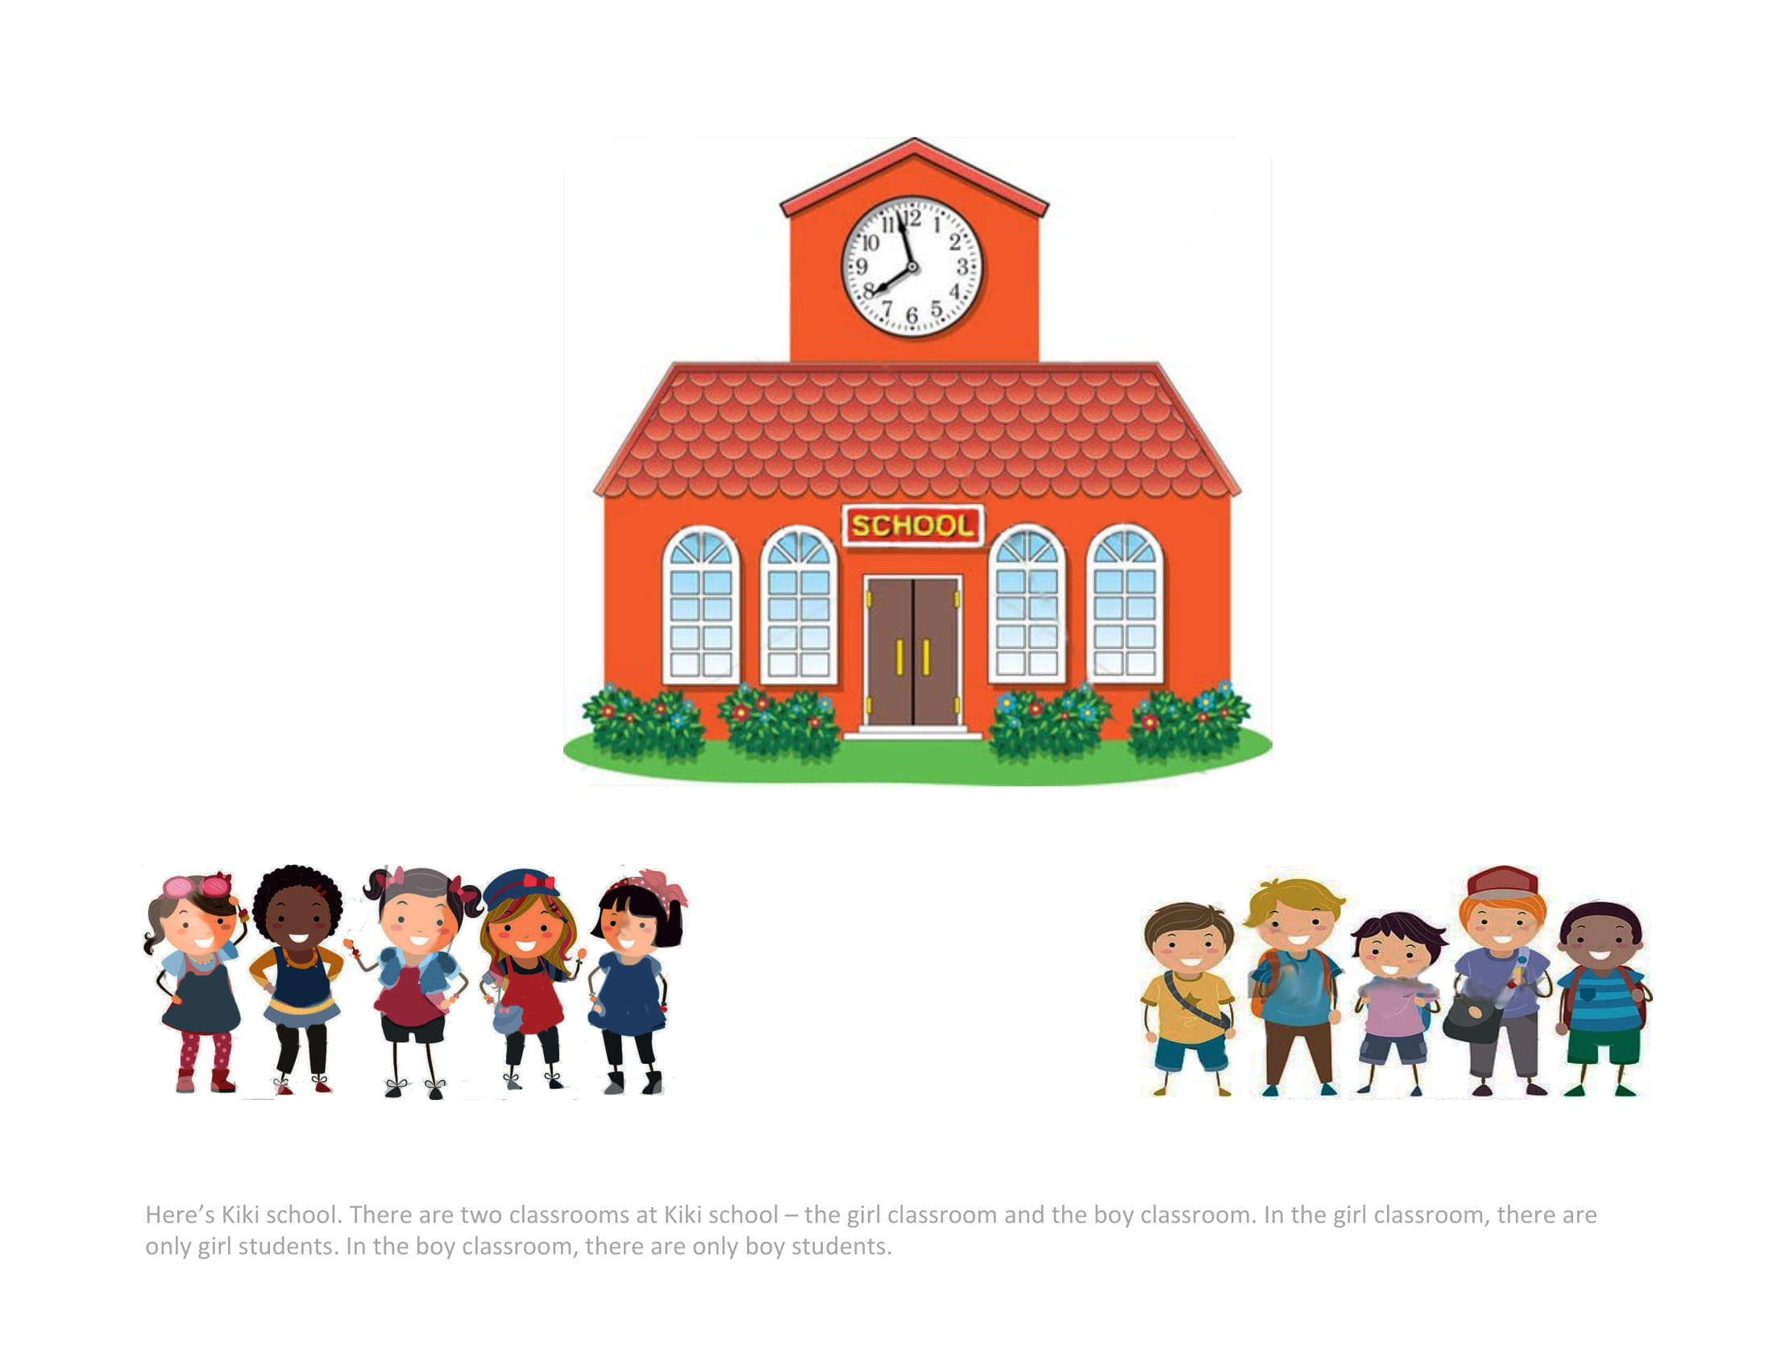
Notes:
Here's Kiki school. There are two classrooms at Kiki school - the girl classroom and the boy classroom. In the girl classroom, there are only girl students. In the boy classroom, there are only boy students.

Slide 5
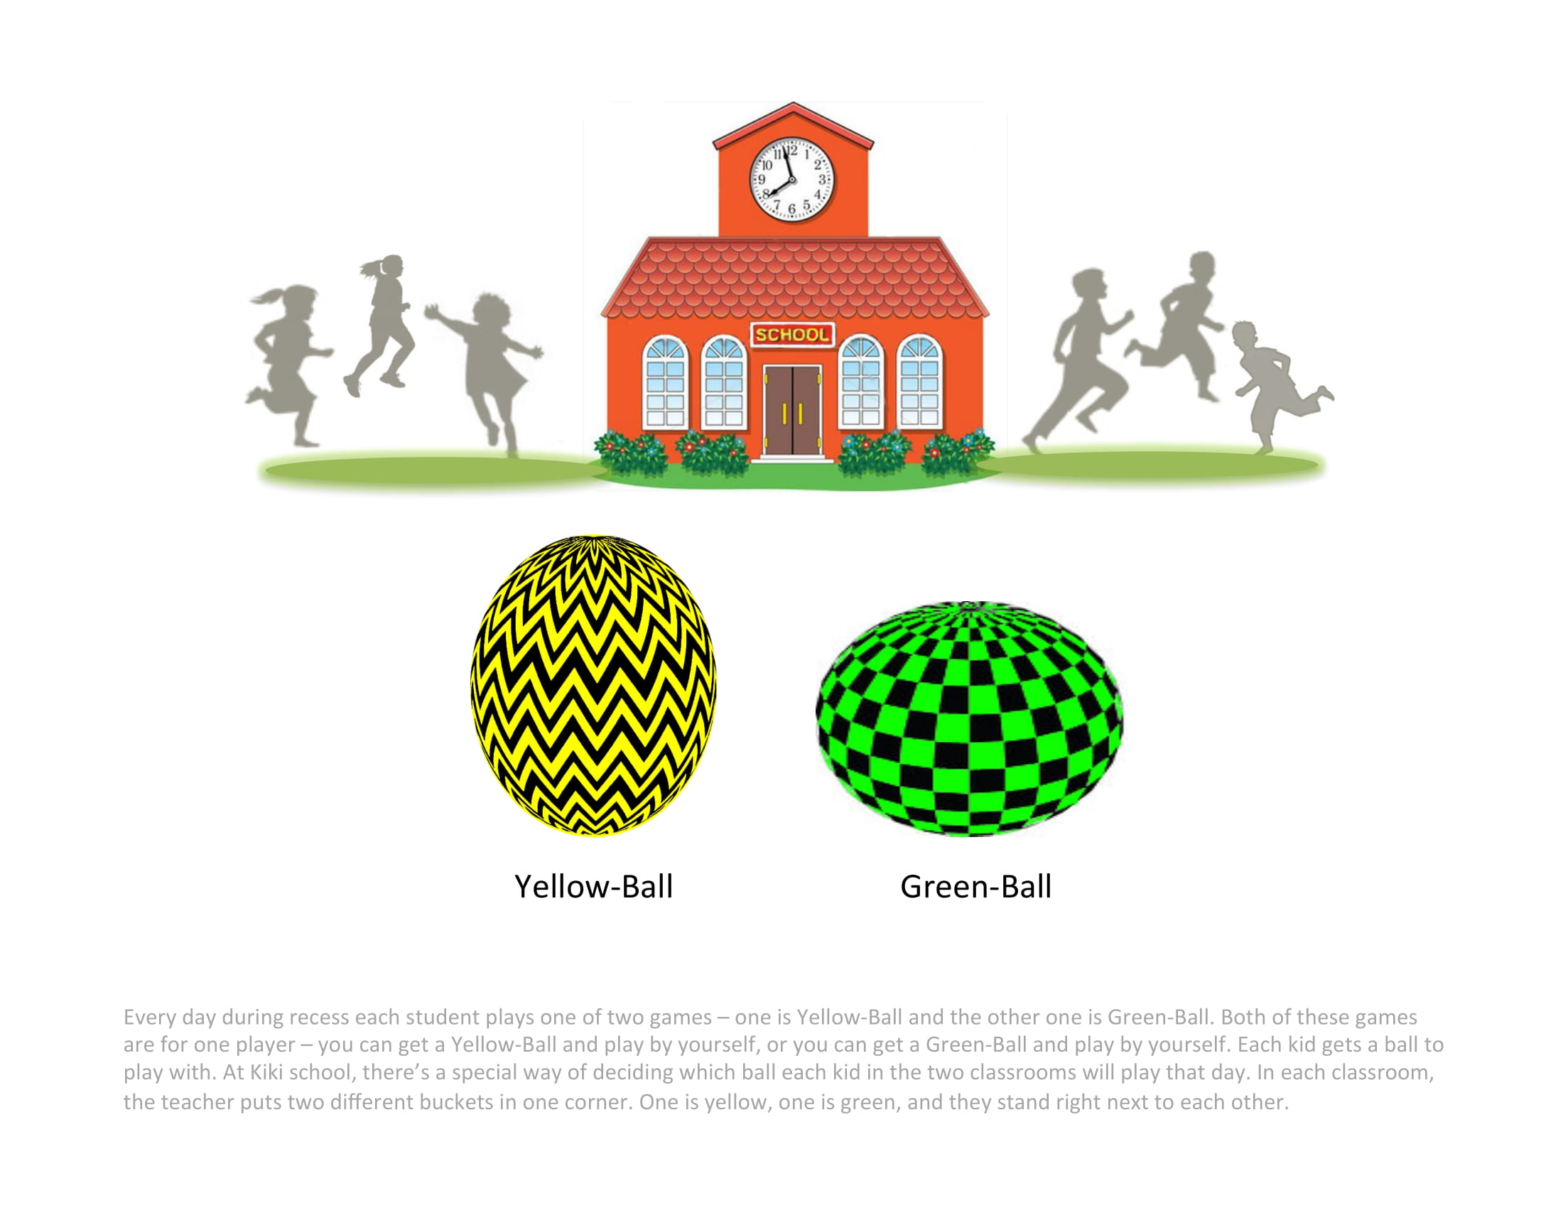
Every day during recess each student plays one of two games – one is Green-Ball and the other one is Yellow-Ball. Both of these games are for one player – you can get a Green-Ball and play by yourself, or you can get a Yellow-Ball and play by yourself. Each kid gets a ball to play with. At Kiki school, there’s a special way of deciding which ball each kid in the two classrooms will play that day. In each classroom, the teacher puts two different buckets in one corner. One is green, one is yellow, and they stand right next to each other.
Notes:
Every day during recess each student plays one of two games – one is Green-Ball and the other one is Yellow-Ball. Both of these games are for one player – you can get a Green-Ball and play by yourself, or you can get a Yellow-Ball and play by yourself. Each kid gets a ball to play with. At Kiki school, there’s a special way of deciding which ball each kid in the two classrooms will play that day. In each classroom, the teacher puts two different buckets in one corner. One is green, one is yellow, and they stand right next to each other.

Slide 6
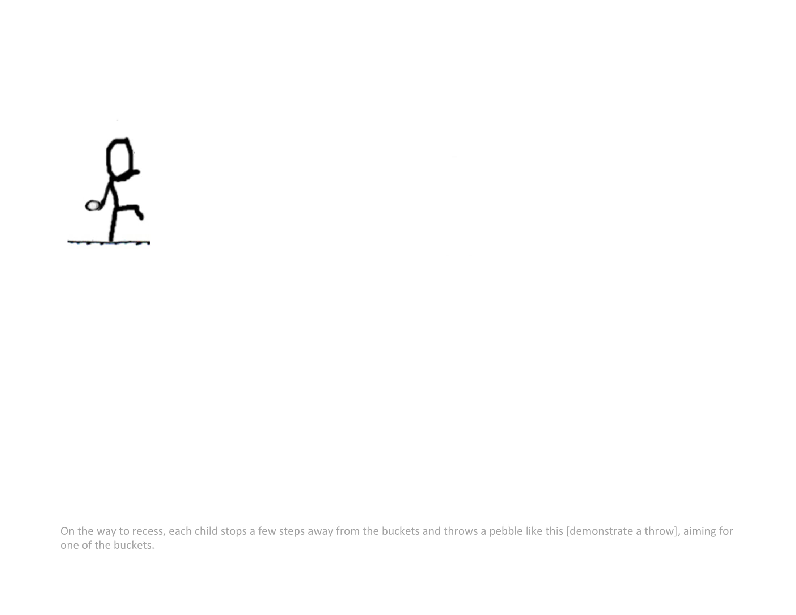
Notes:
On the way to recess, each child stops a few steps away from the buckets and throws a pebble like this [demonstrate a throw], aiming for one of the buckets.

Slide 7
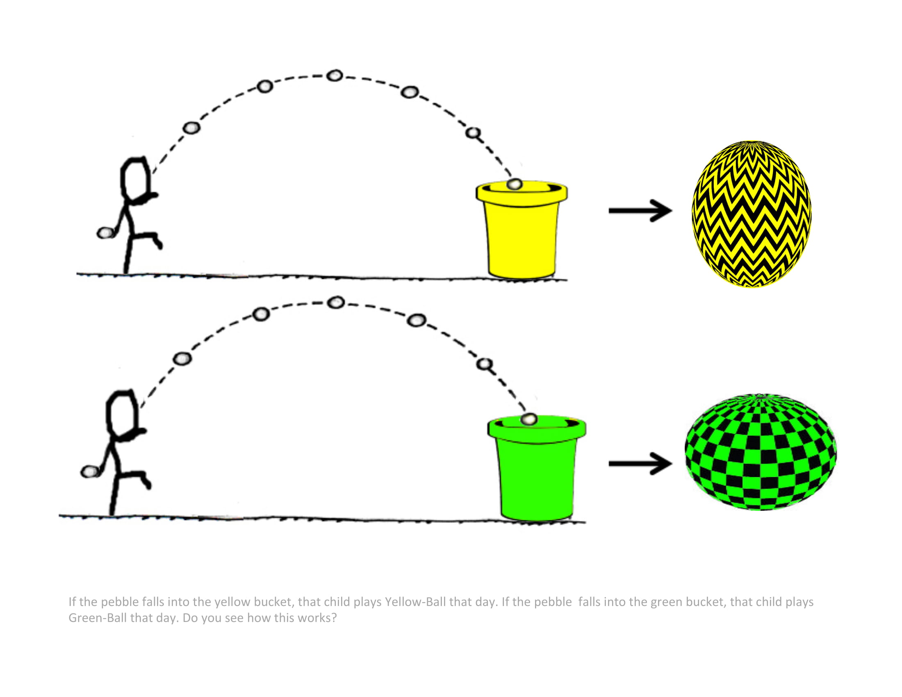
If the pebble falls into the green bucket, that child plays Green-Ball that day. If the pebble falls into the yellow bucket, that child plays Yellow-Ball that day. Do you see how this works?
Notes:
If the pebble falls into the green bucket, that child plays Green-Ball that day. If the pebble falls into the yellow bucket, that child plays Yellow-Ball that day. Do you see how this works?

Slide 8
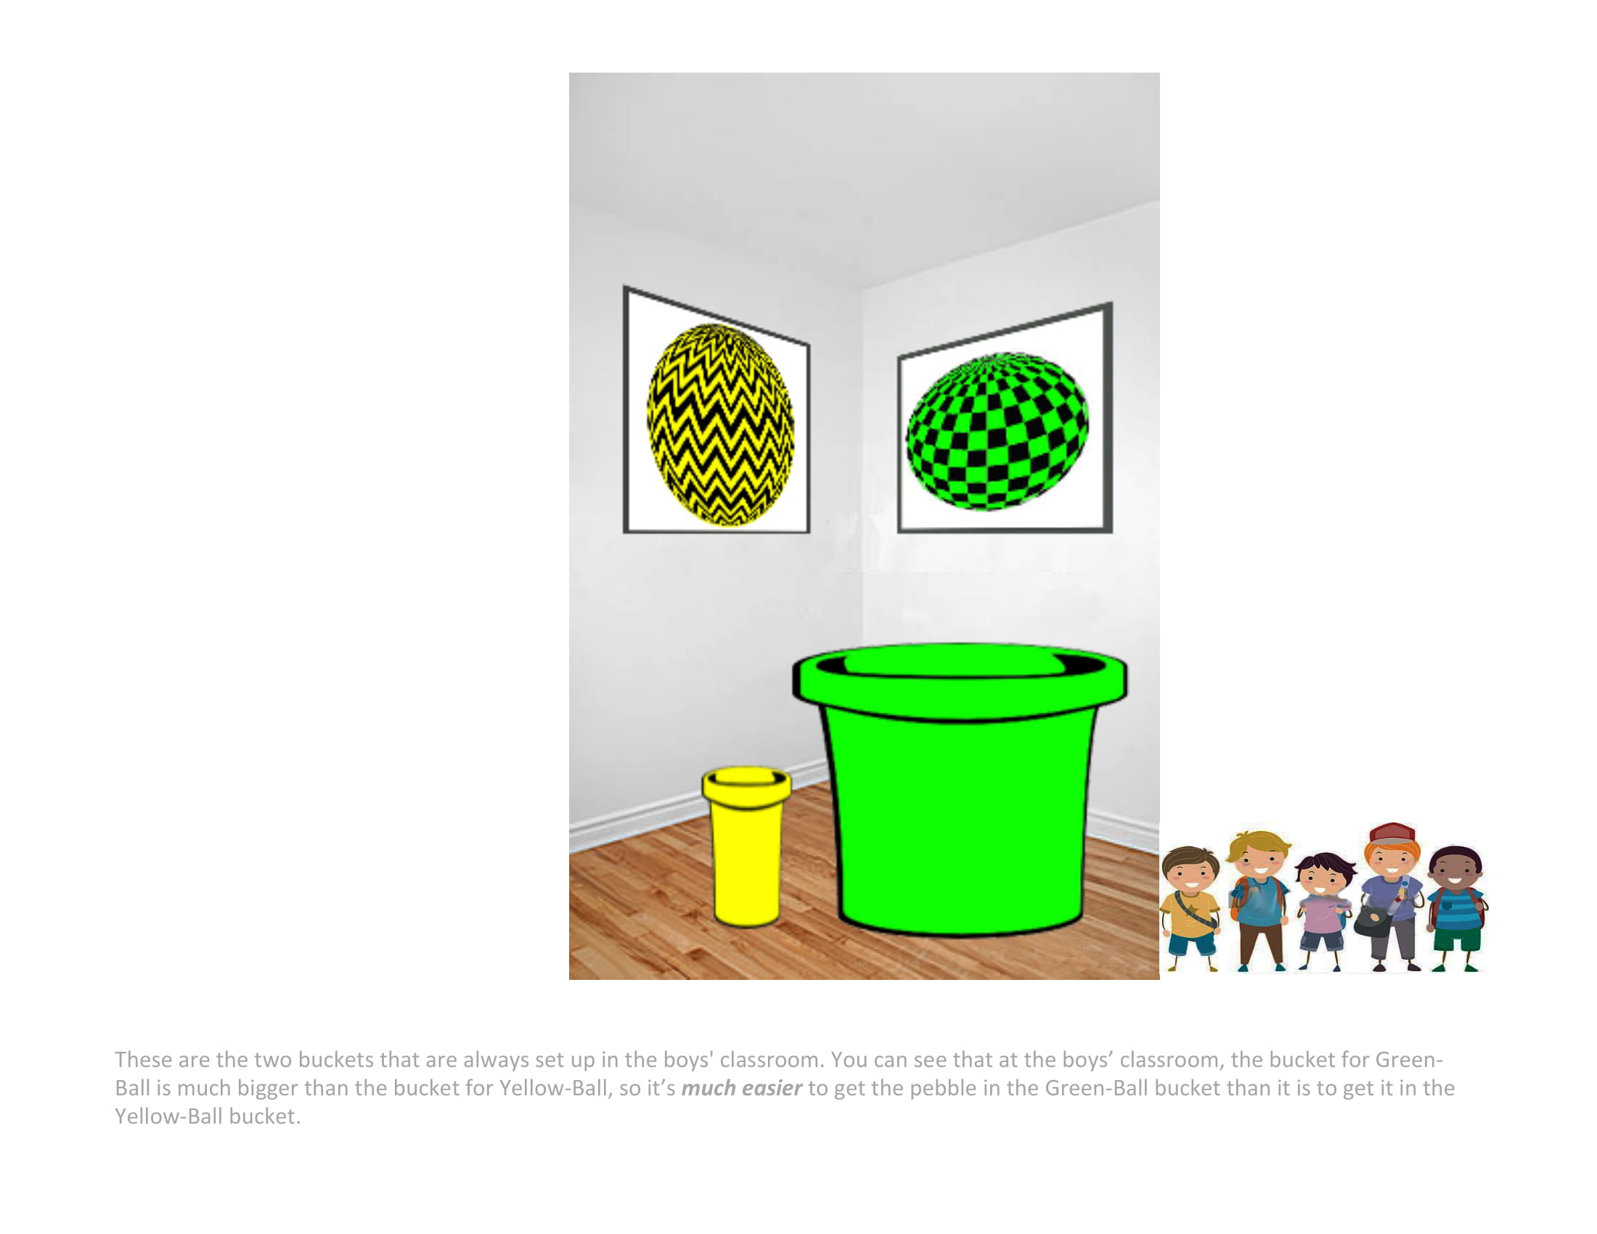
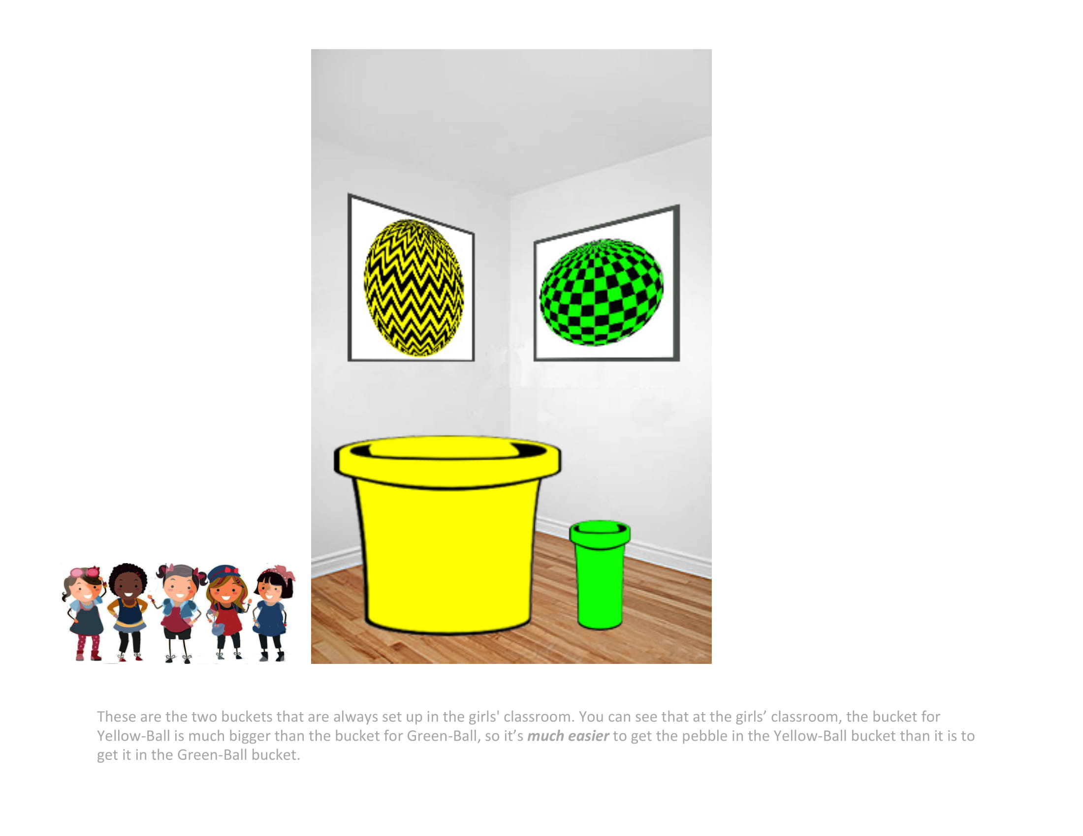
These are the two buckets that are always set up in the boys' classroom. You can see that at the boys’ classroom, the bucket for Yellow-Ball is much bigger than the bucket for Green-Ball, so it’s much easier to get the pebble in the Yellow-Ball bucket than it is to get it in the Green-Ball bucket.
Notes:
These are the two buckets that are always set up in the boys' classroom. You can see that at the boys’ classroom, the bucket for Yellow-Ball is much bigger than the bucket for Green-Ball, so it’s much easier to get the pebble in the Yellow-Ball bucket than it is to get it in the Green-Ball bucket.

Slide 9
These are the two buckets that are always set up in the girls' classroom. You can see that at the girls’ classroom, the bucket for Green-Ball is much bigger than the bucket for Yellow-Ball, so it’s much easier to get the pebble in the Green-Ball bucket than it is to get it in the Yellow-Ball bucket.
Notes:
These are the two buckets that are always set up in the girls' classroom. You can see that at the girls’ classroom, the bucket for Green-Ball is much bigger than the bucket for Yellow-Ball, so it’s much easier to get the pebble in the Green-Ball bucket than it is to get it in the Yellow-Ball bucket.

Slide 10
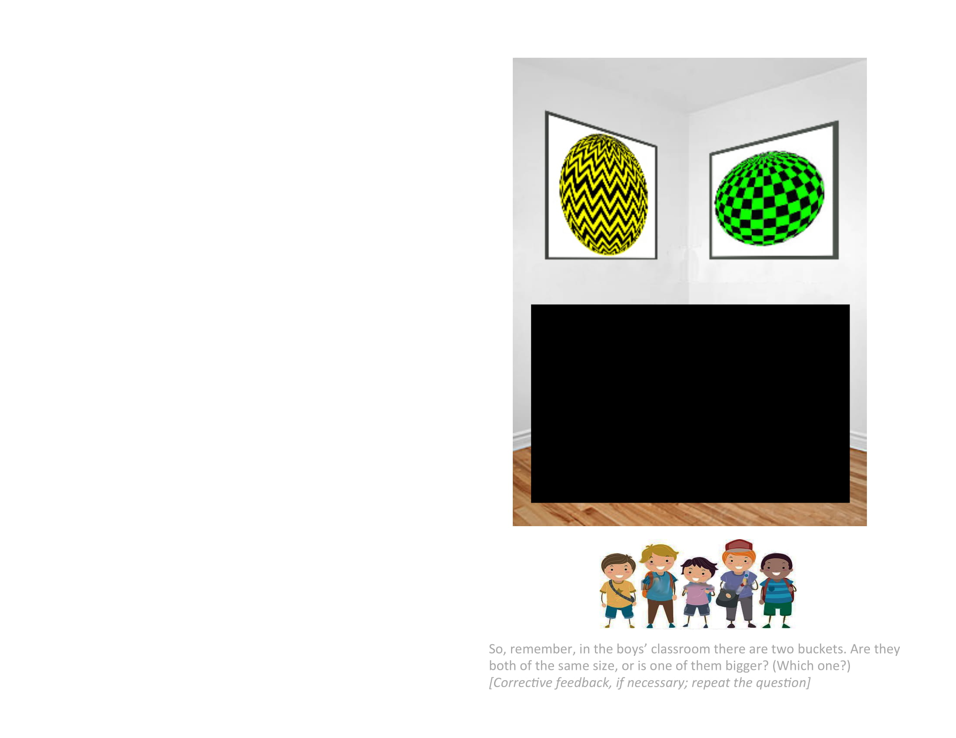
Notes:
So, remember, in the boys’ classroom there are two buckets.
*Are they both of the same size, or is one of them bigger? [Corrective feedback if necessary; repeat the question]

Slide 11
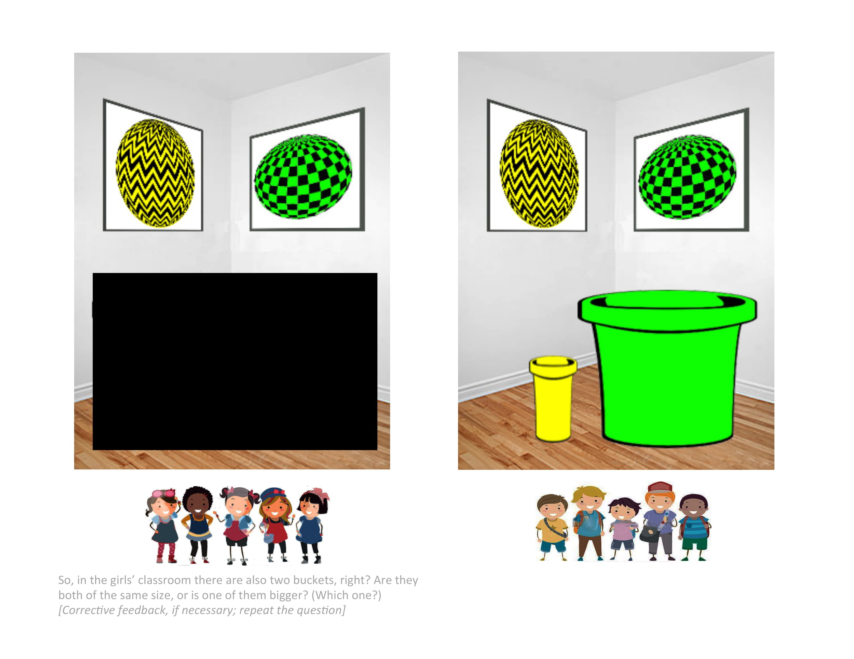
Which one is bigger?
Notes:
**Which one is bigger? [wait for response] Right, the yellow one!

Slide 12
Notes:
So, in the girls’ classroom there are also two buckets, right?
**Are they both of the same size, or is one of them bigger? Which one? [Corrective feedback if necessary; repeat the question]

Slide 13
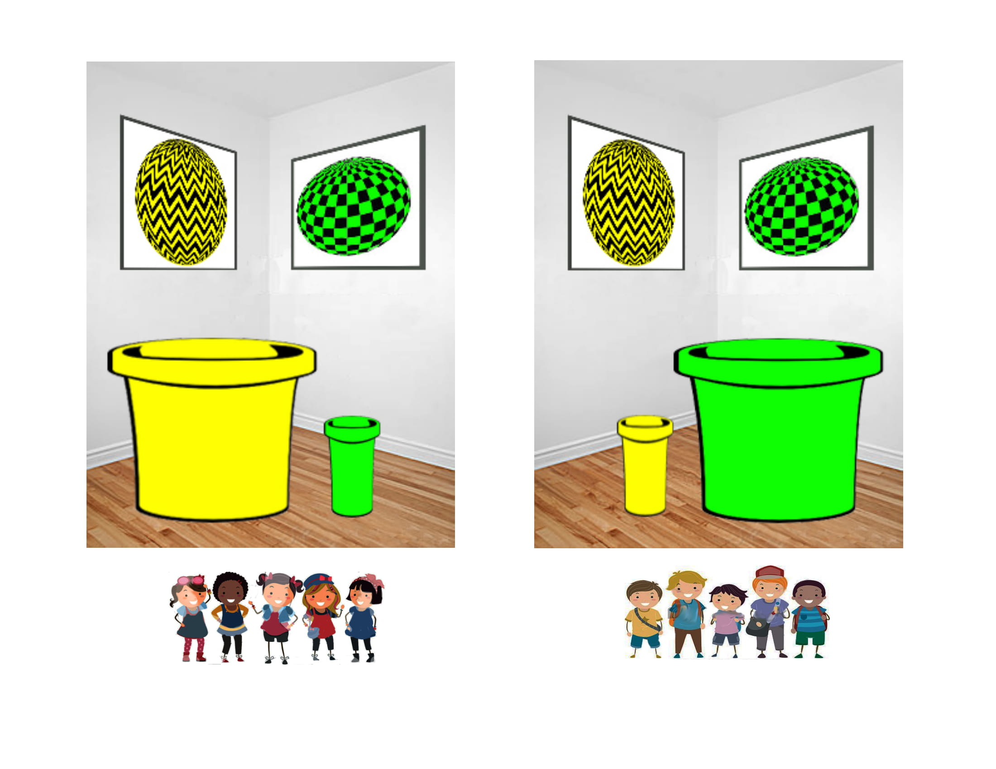

Slide 14
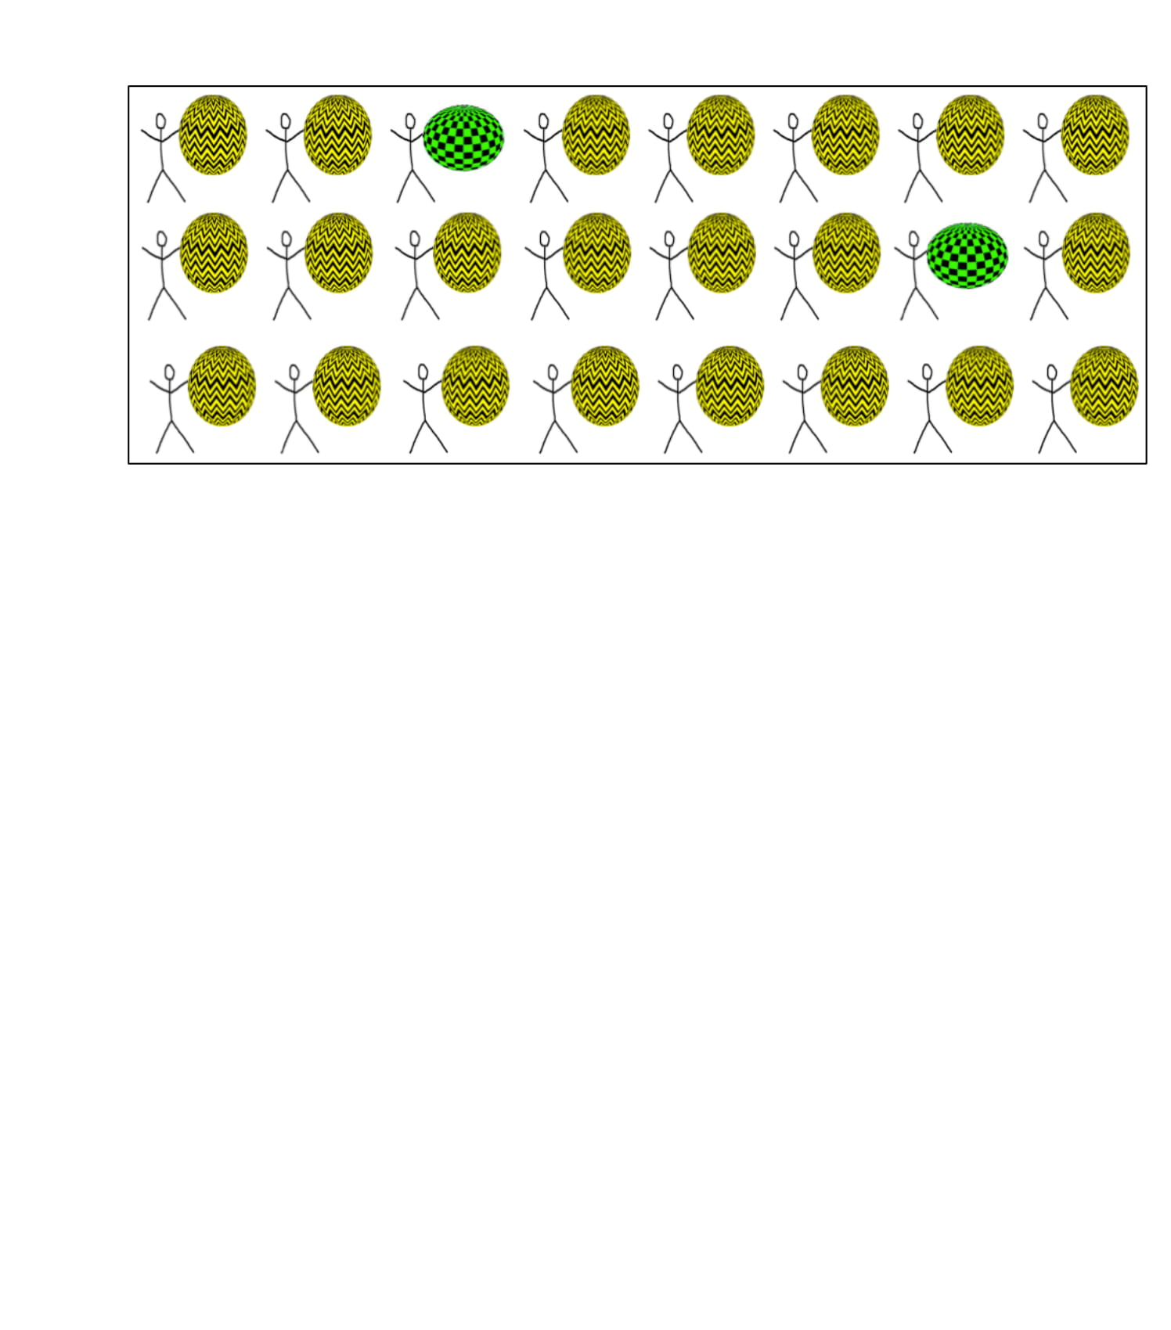
Here’s how many boys in the boys’ classroom played each game one day; one boy played Yellow-Ball, the next one played Yellow-Ball, the next one played Green-Ball, the next one Yellow-Ball, and so on. So you can see which game each boy played that day.
Notes:
Here’s how many boys in the boys’ classroom played each game one day; one boy played Yellow-Ball, the next one played Yellow-Ball, the next one played Green-Ball, the next one Yellow-Ball, and so on. So you can see which game each boy played that day.

Slide 15
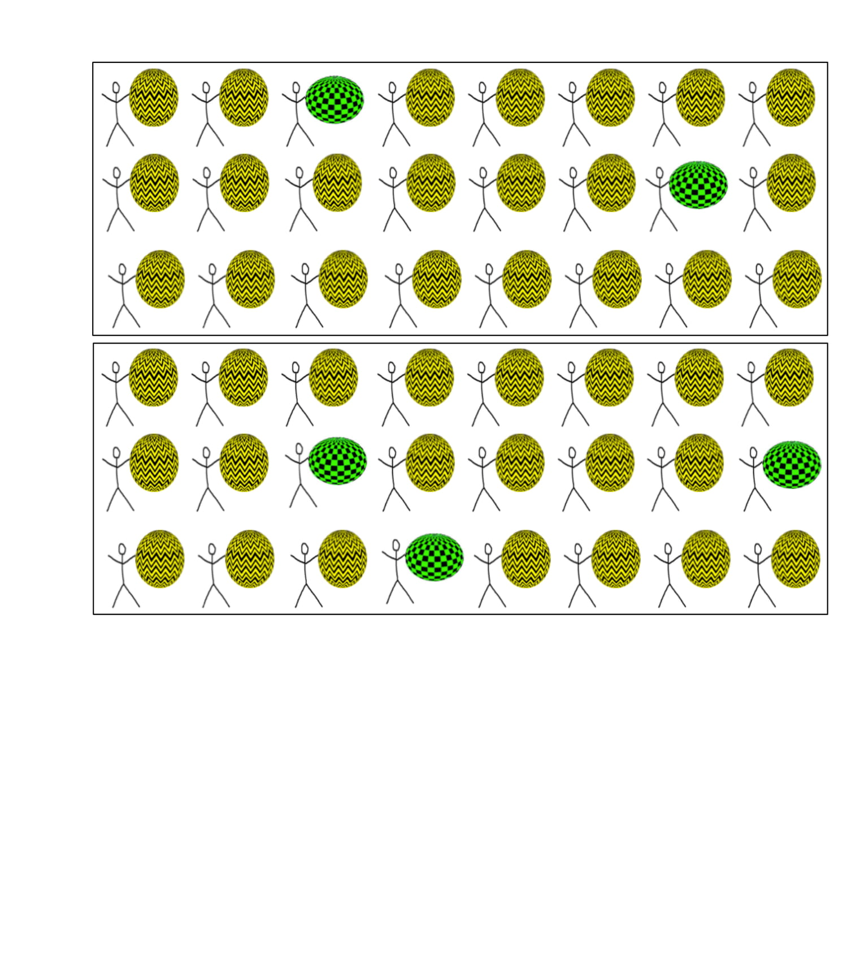
And here's how many boys in the boys' classroom played each game another day.
Notes:
And here's how many boys in the boys' classroom played each game another day.

Slide 16
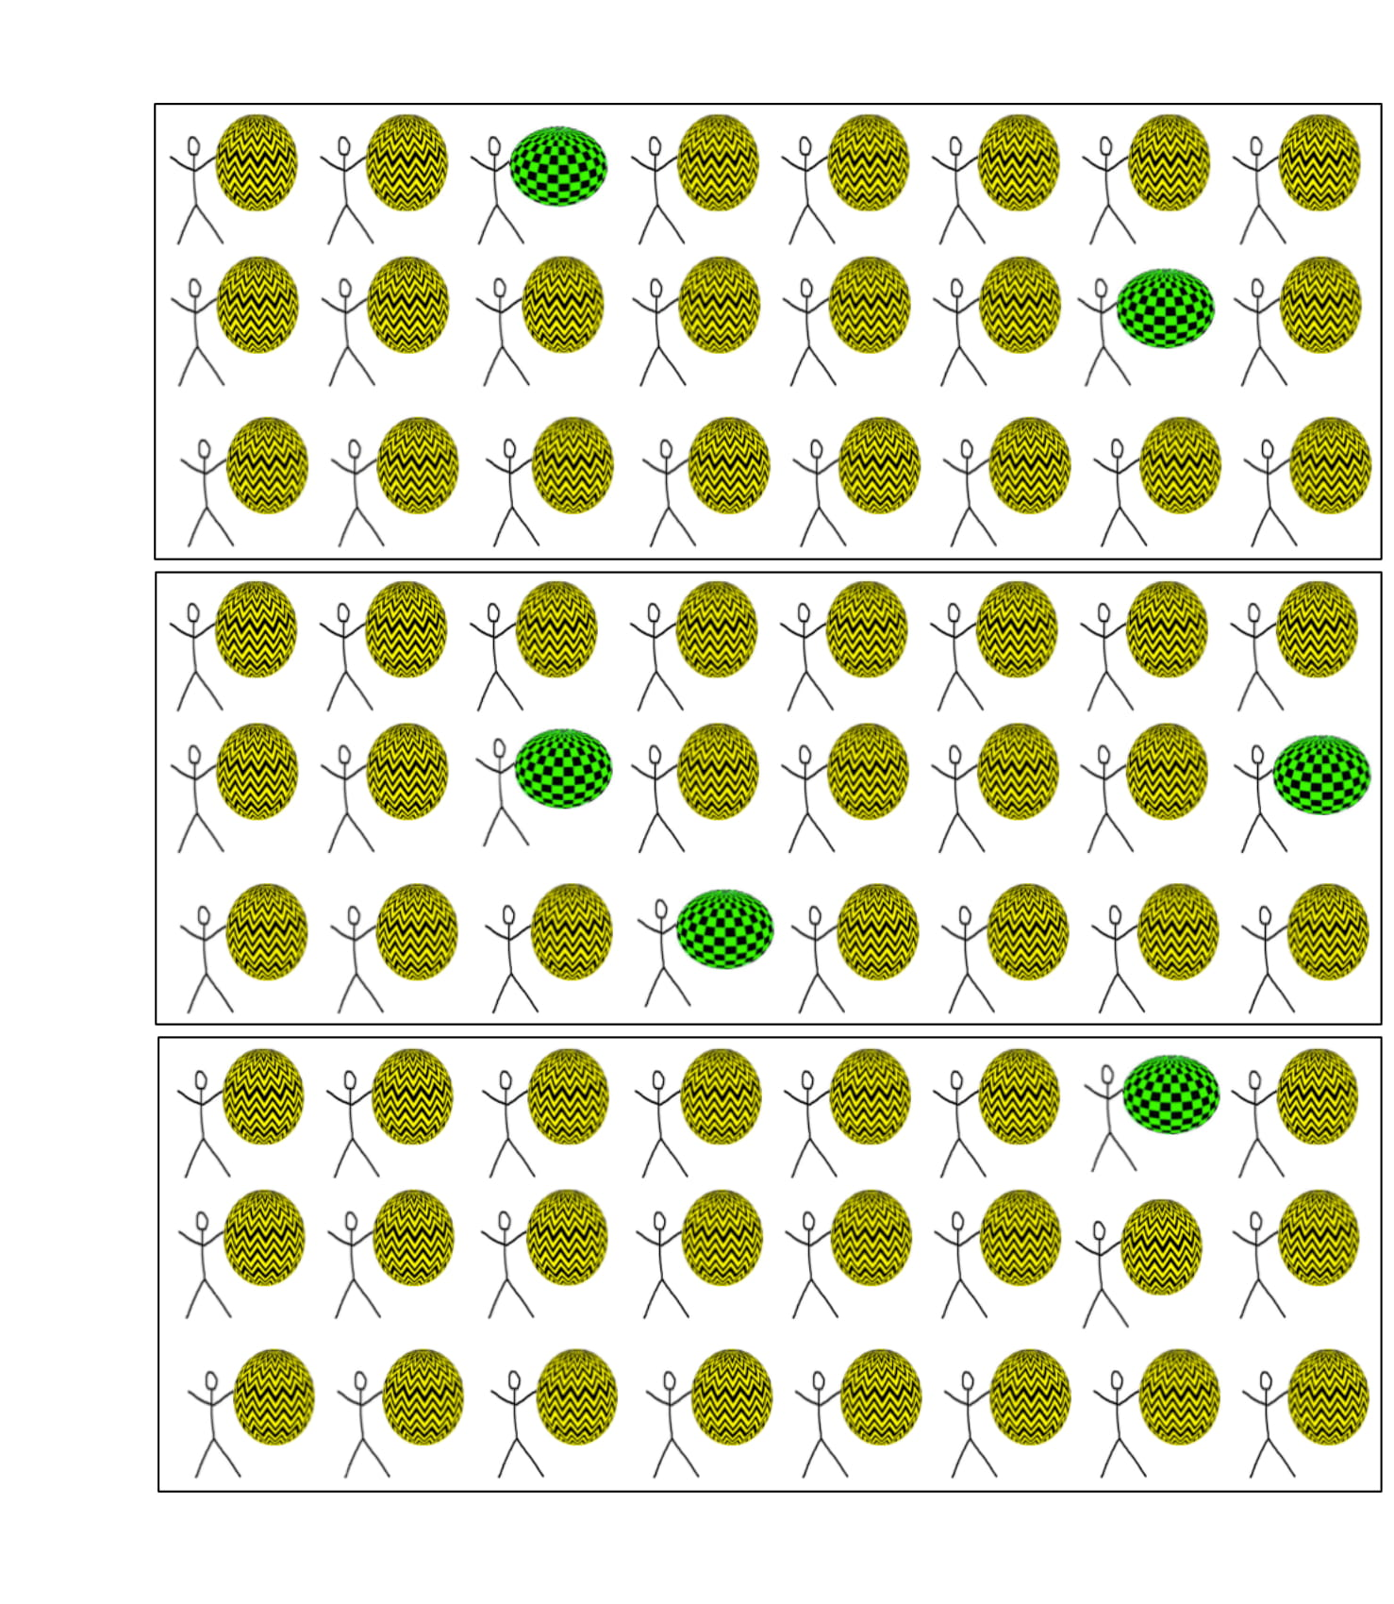
And here's another day at the boys' classroom.
So these are the games from the boys' classroom. Which game did the boys play most often? Yellow-Ball or Green-Ball?
Notes:
And here's another day at the boys' classroom.
**So these are the games from the boys' classroom. Which game did the boys play most often? Yellow-Ball or Green-Ball?
Feedback: Right, Yellow-Ball. /OR/ Let’s see, can you show me the boys that played Green-Ball? And can you show me the boys that played Yellow-Ball? So which game did the boys play most often?

Slide 17
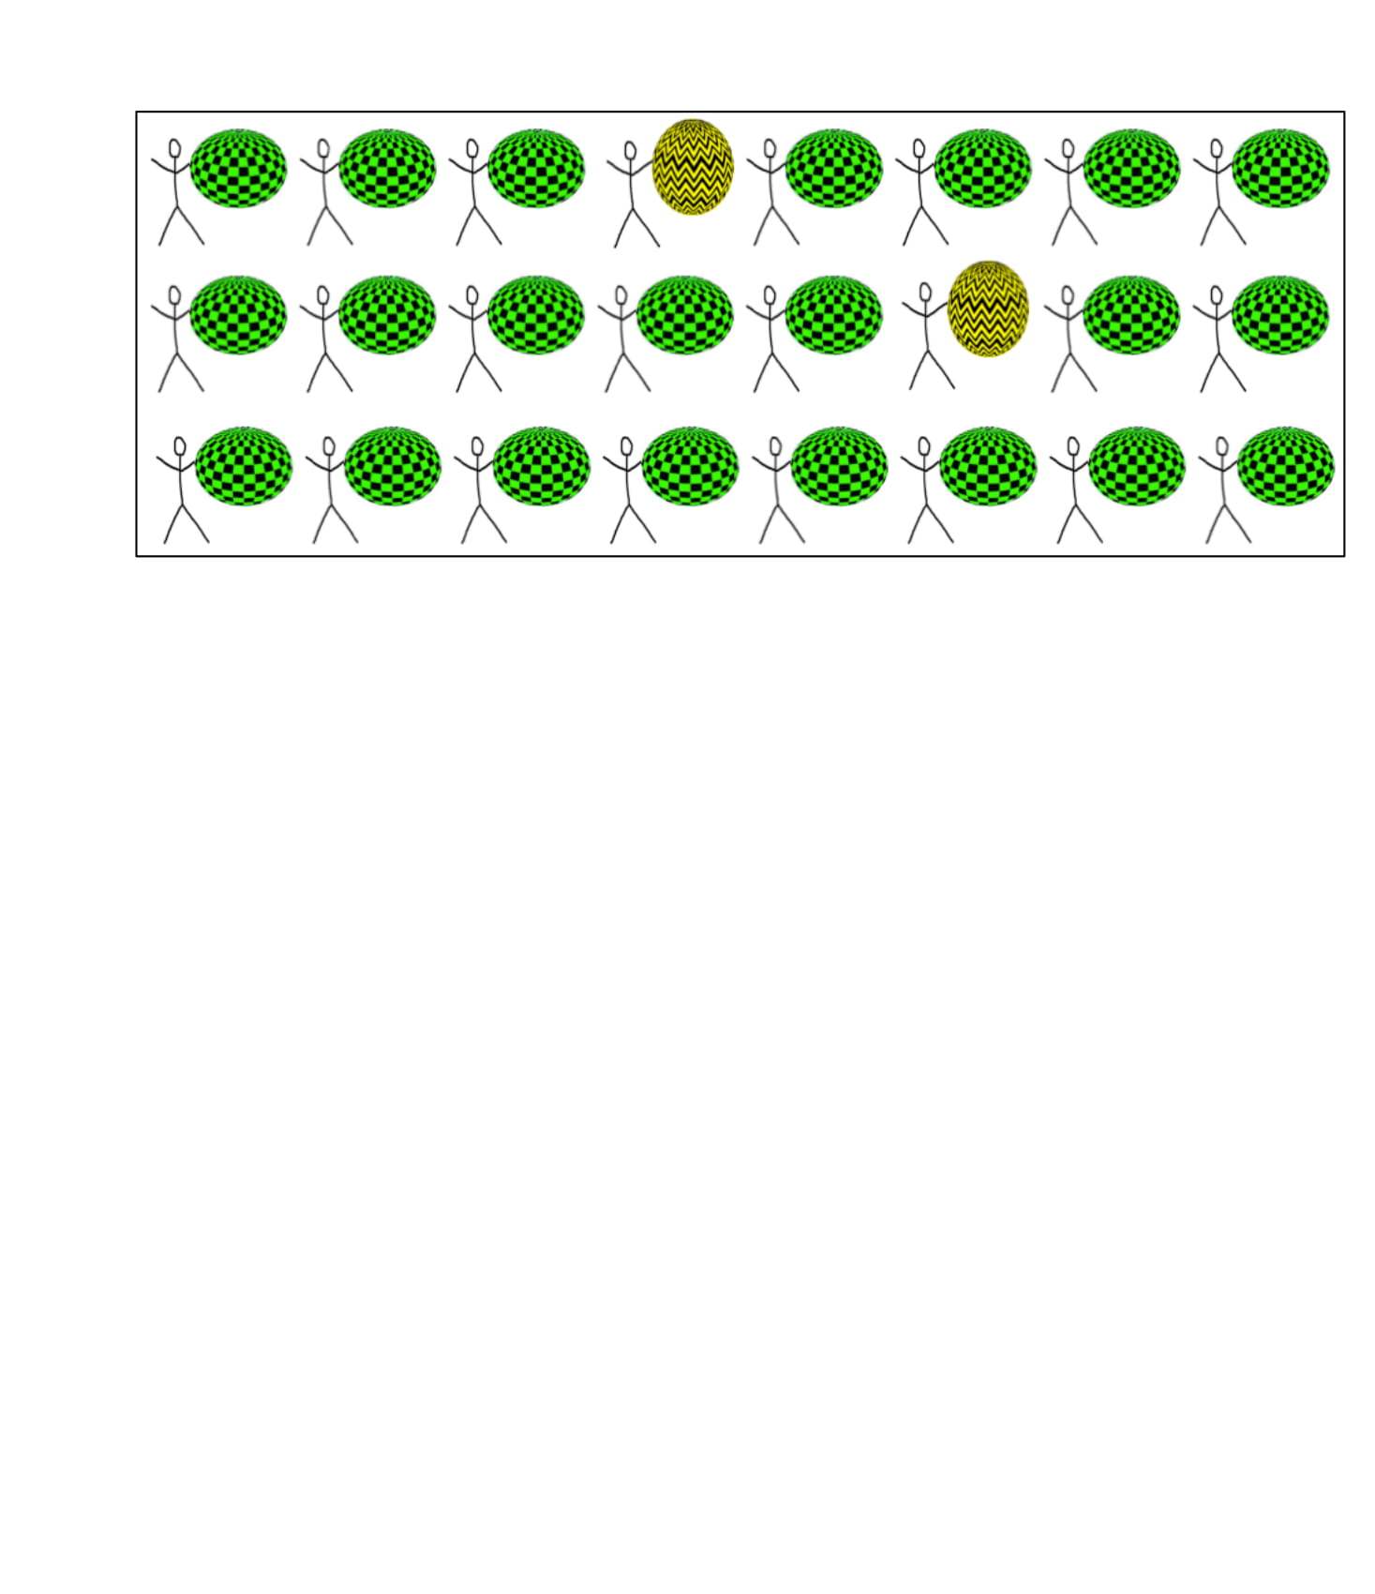
Here’s how many girls in the girls’ classroom played each game one day: one girl played Green-Ball, the next one played Green-Ball, the next one played Green-Ball, the next one played Yellow-Ball, and so on. So you can see which game each girl played that day.
Notes:
Here’s how many girls in the girls’ classroom played each game one day: one girl played Green-Ball, the next one played Green-Ball, the next one played Green-Ball, the next one played Yellow-Ball, and so on. So you can see which game each girl played that day.

Slide 18
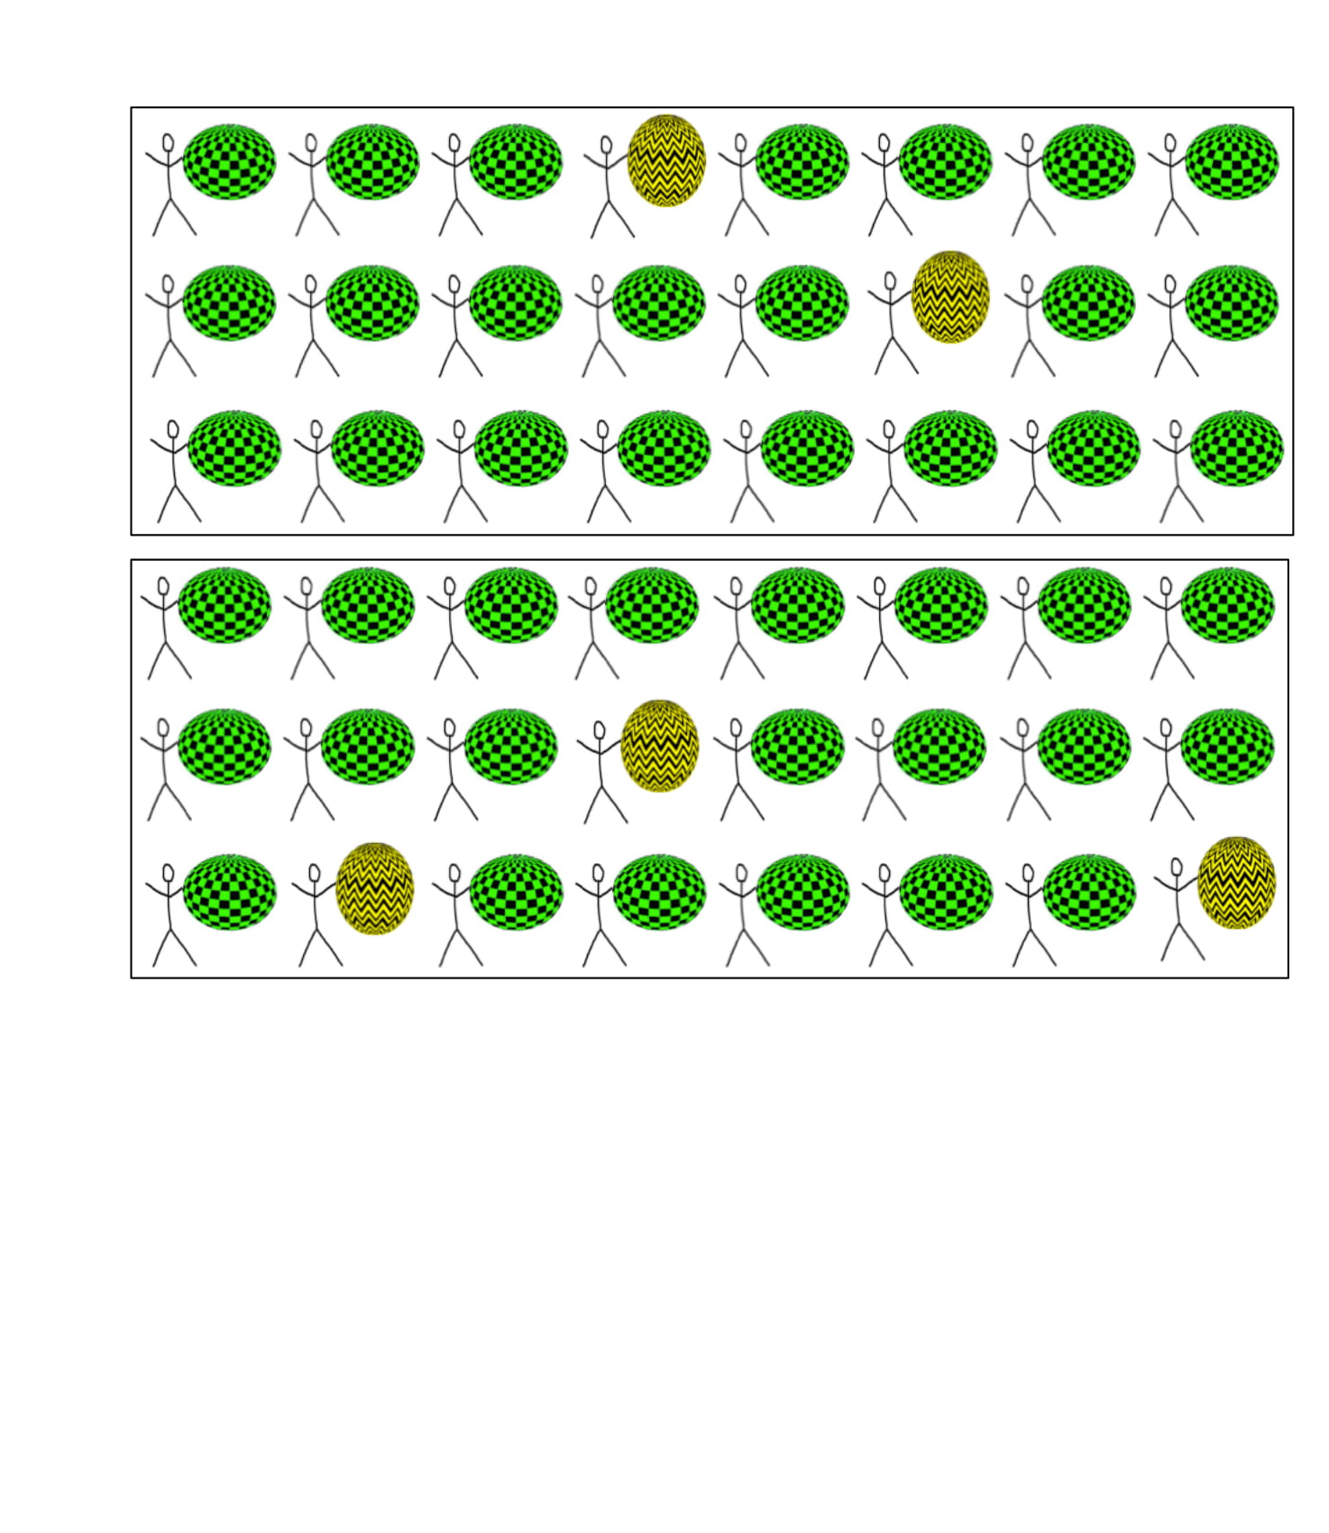
And here's another day at the girls' classroom.
Notes:
And here's another day at the girls' classroom.

Slide 19
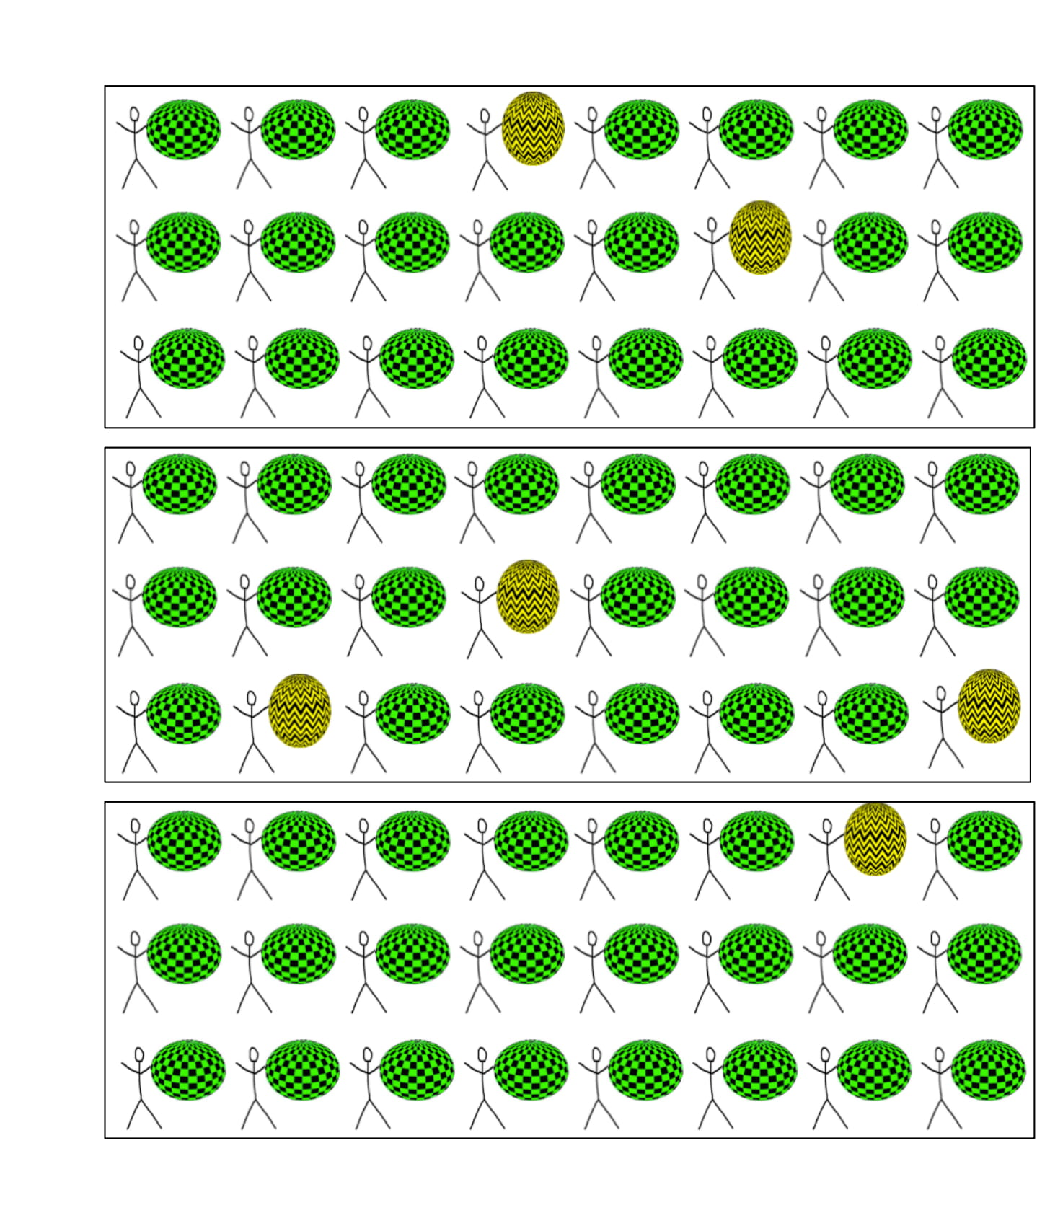
And here's another day at the girls' classroom.
So, there are the games from the girls' classroom. Which game did the girls play most often? Yellow-Ball or Green-Ball?
Notes:
And here's another day at the girls' classroom.
**So, there are the games from the girls' classroom. Which game did the girls play most often? Yellow-Ball or Green-Ball?
Feedback: Right, Green-Ball. /OR/ Let’s see, can you show me the girls that played Yellow-Ball? And can you show me the boys that played Green-Ball? So which game did the girls play most often?

Slide 20
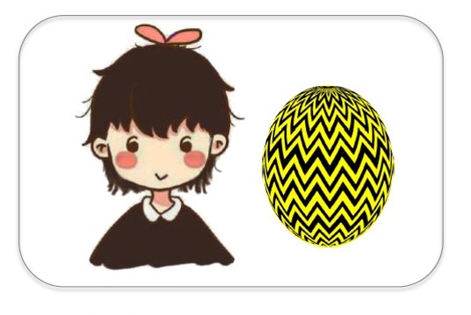
Here’s Suzy. She plays Green-Ball because she is a girl.
Notes:
Here’s Suzy. She plays Green-Ball because she is a girl.

Slide 21
Now, here’s a question for you: Suzy is 8 years old.
Notes:
Now, here’s a question for you: Suzy is 8 years old.

Slide 22

Do you think she played Green-Ball when she was 4 years old?
Notes:
** Do you think she played Green-Ball when she was 4 years old? (Y/N)

Slide 23
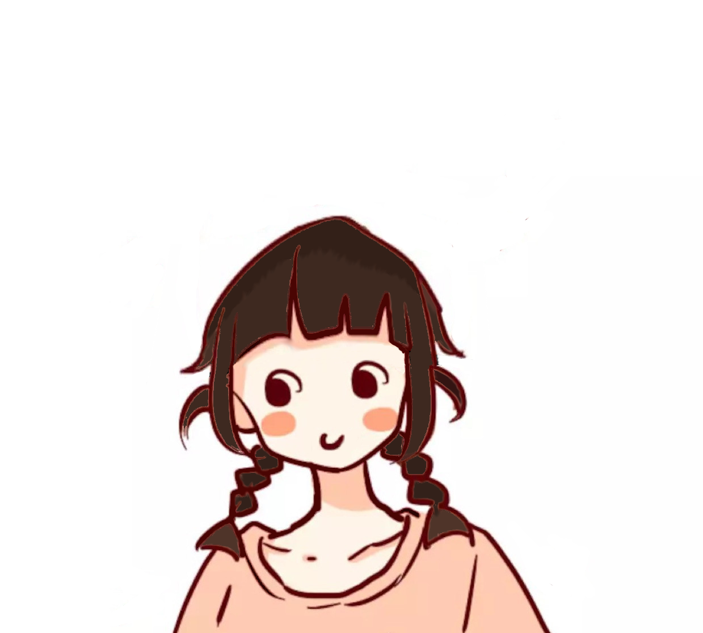
Do you think she will always play Green-Ball?
Notes:
** Do you think she will always play Green-Ball? (Y/N)

Slide 24
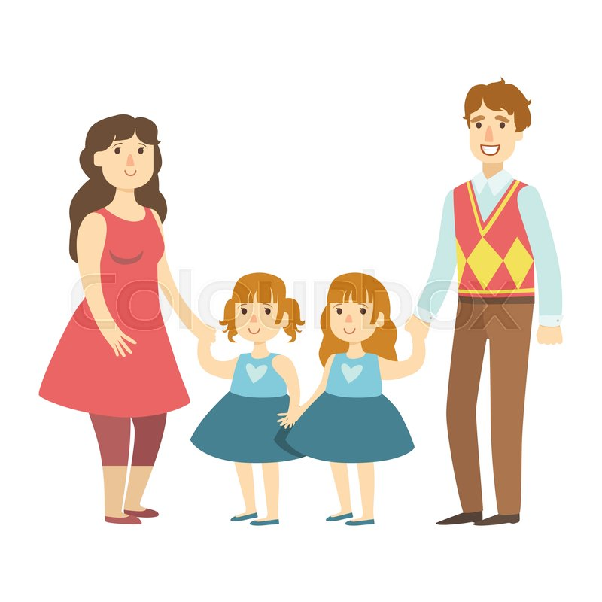

Would Suzy stop playing Green-Ball if her family tried to stop her from playing Green-Ball?
Notes:
**Would Suzy stop playing Green-Ball if her family tried to stop her from playing Green-Ball? (Y/N)

Slide 25
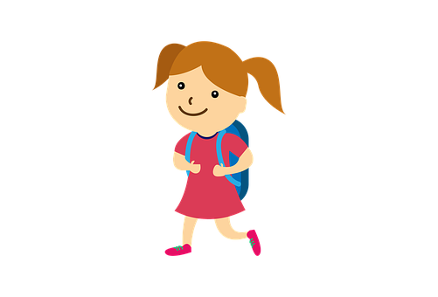
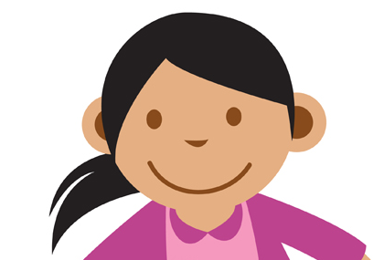
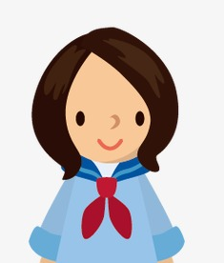
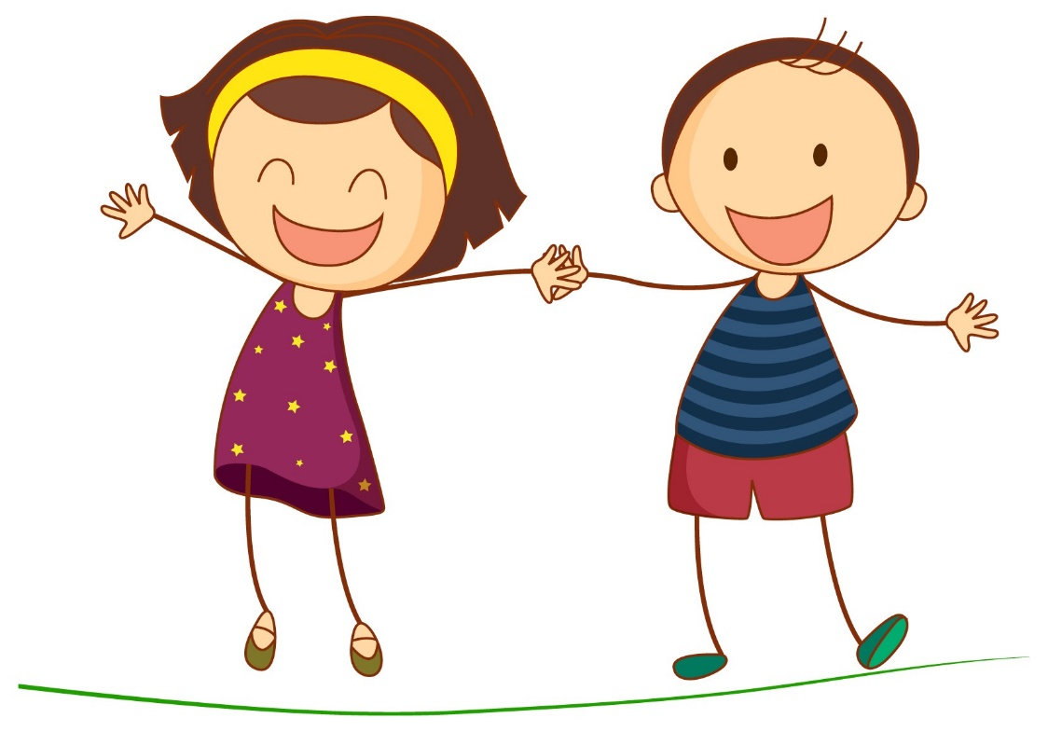
Do you think “just this girl,” “a few girls,” or “a whole lot of girls” play Green-Ball?
Notes:
**Do you think “just this girl,” “a few girls,” or “a whole lot of girls” play Green-Ball? (just this girl / a few girls / a whole lot of girls)

Slide 26
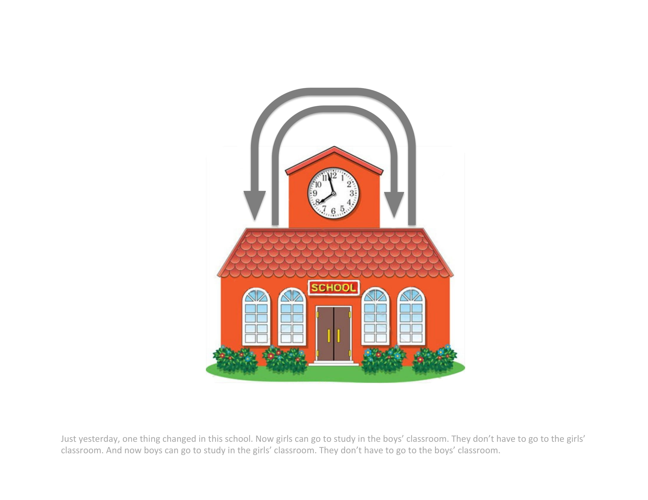
Notes:
Just yesterday, one thing changed in this school. Now girls can go to study in the boys’ classroom. They don’t have to go to the girls’ classroom. And now boys can go to study in the girls’ classroom. They don’t have to go to the boys’ classroom.

Slide 27
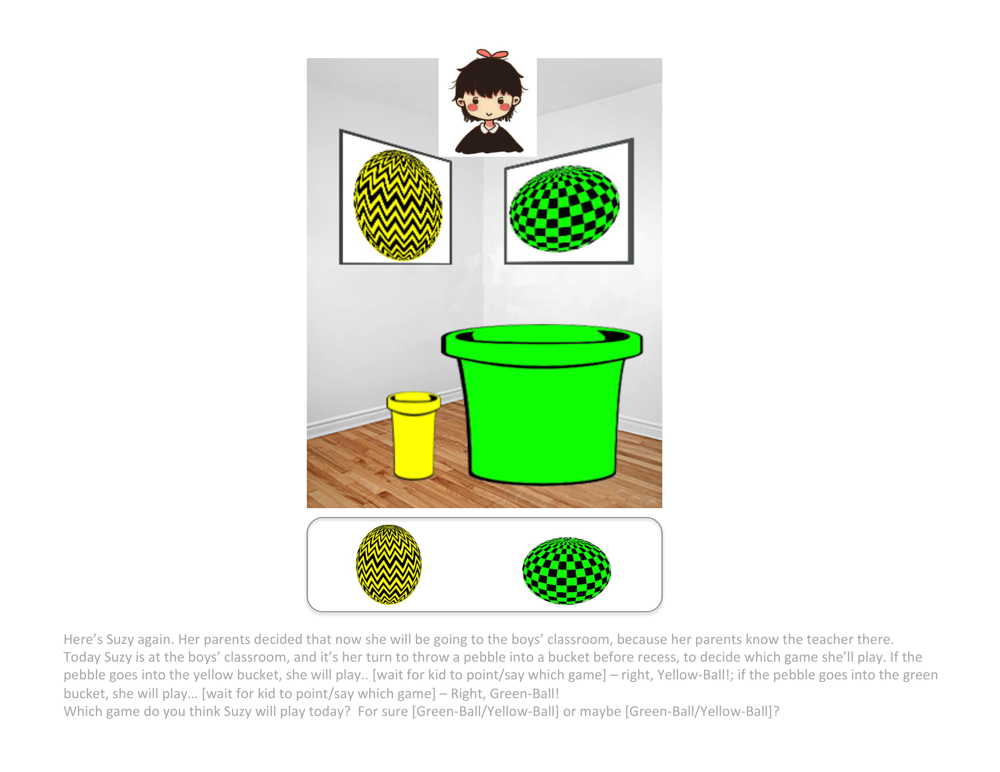
Notes:
Here’s Suzy again. Her parents decided that now she will be going to the boys’ classroom, because her parents know the teacher there. Today Suzy is at the boys’ classroom, and it’s her turn to throw a pebble into a bucket before recess, to decide which game she’ll play.
If the pebble goes into the yellow bucket, she will play… [wait for kid to point/say which game] – right, Yellow-Ball! If the pebble goes into the green bucket, she will play… [wait for kid to point/say which game] – right, Green-Ball!
**Which game do you think Suzy will play today? For sure [Green-Ball / Yellow-Ball] or maybe [Green-Ball/Yellow-Ball]?

Slide 29
Age | Pilot | Final sample | Excluded
5
6

